Slide 1
Knowledge Based Decision Support Systems
RULE-BASED SYSTEMS
FAST-NU
DR. KASHIF ZAFAR
Ref: Artificial Intelligence; A Guide to Intelligent Systems
Michael Negnevitsky
Notes:
If you put enough knowledge into the rule base so that it can perform some interesting complex task at same performance level as human then its an expert system

Slide 2
Human Expert | Expert Systems | Conventional Program
Use knowledge in form of heuristics to solve problems in narrow domain | Process knowledge expressed as rules, use symbolic reasoning to solve problems in narrow domain | Process data & use algorithms to solve general numerical problems
Knowledge exists as compiled form in brain | Knowledge & Processing clearly separated | No separation of knowledge & control structure
Capable of explaining reasoning and providing details | Trace rules fired & explain how conclusion reached and why specific data needed | No explanation
Use inexact reasoning, can deal with incomplete, uncertain, fuzzy information | Permit inexact reasoning, can deal with incomplete, uncertain, fuzzy information | Only work with complete exact data
Can make mistakes when information is incomplete or fuzzy | Can make mistakes when information is incomplete or fuzzy | Provide no solution when information is incomplete or fuzzy
Quality of problem solving improves with practice & training. Process is slow, inefficient & expensive | Quality of problem solving improves by adding new rules or adjusting old ones. Changes are easy. | Quality of problem solving improves by changing program code – affects knowledge & processing. Change difficult

Slide 3

Expert Systems Development Team
Expert System
Development Team
Project Manager
Domain Expert
Knowledge
Engineer
Programmer
Expert System
End-User
Notes:
Knowledge is provided by a human expert and we want to put that into a computer
Need the computer to act as an intelligent assistant in some specific domain of expertise or to solve a problem that would otherwise have to be solved by an expert
Most popular are rule-based

Slide 4
Development Team
Domain Expert
  Knowledgeable & skilled person capable of solving problems in specific domain
Knowledge engineer
  Capable of designing, building and testing expert system
Programmer
  Develop knowledge & data representation structures
  Control structure
  Dialog structure
Project manager
End-User
Notes:
Five members of the development team – the success depends on how well they work together
Domain expert: knowledgeable and skilled person capable of solving problems in the specific domain
Their expertise has to be captured, expert must be willing and able to communicate their knowledge and commit substantial amount of time to expert system development
Knowledge engineer: person capable of designing, building and testing an expert system. Responsible for selecting an appropriate task for the expert system. Interviews expert to find out how a particular problem is solved. Through this interaction they establish the reasoning methods expert uses to handle facts and rules and decides how to represent them in the system. Chooses development software for encoding the knowledge and tests, revises and integrates the system into the workplace. Involved from initial design to completion
Programmer: responsible for programming knowledge in terms that a computer can understand. Need skills in symbolic programming LISP, Prolog . If using expert system shell grand otherwise must translate into more traditional programming languages. And develop the knowledge and dat

Slide 5
Components of Rule-Based Expert System
Knowledge Base
  Contains domain knowledge useful for problem solving
  In rule-based approach
    KB is called Rule Base or Production Memory
    Stores Rules ( Procedural knowledge)
Database
  Contains set of facts to match against conditions
  Abstracted representation of system
  Represents current state of the world
Inference Engine
  Rule Interpreter
  Carries out reasoning to achieve solution
  Links rules in knowledge base with facts in the database
Notes:
Database : left-hand side of rules look at it to see if conditions are satisfied, right-hand sides operate on it
This is where facts are stored

Slide 6
Components of Rule-Based Expert System
Explanation Facilities
  Explain reasoning and justify advice
User Interface
Notes:
Explain how a particular conclusion was reached
Why a specific fact is needed

Slide 7
Components of Rule-Based Expert Systems
Knowledge Base
Database
Rules
Facts
Inference Engine
Explanation
Facilities
User interface
User

Slide 8
Additional Components
External Interface
  External Data, Files, Programs in conventional programming languages
Developer Interface
  Knowledge Base Editors, Debugging Aids, Input/Output Facilities
Notes:
Shells : generally have text editor, or some sort of auditing mechanism to keep track of changes
Debugging aids, tracing facilities, break packages.
Input/Output : runtime knowledge acquisition – get information not currently in db

Slide 9
Components of Rule-Based Expert Systems
External
Database
Database
Knowledge Base
External
programs
Facts
Rules
Inference Engine
Explanation
Facilities
Developer
interface
User interface
Knowledge
Engineer
User
Expert

Slide 10
Characteristics of Expert System
Built to perform at human expert level in narrow, specialised domain
  High-quality performance
  Timely solutions
  Use Heuristics to guide reasoning
Explanation Capability
  Enables system to review reasoning and explain decisions
  Traces rules fired
Employ Symbolic Reasoning
Can work with incomplete data
Can make mistakes, just like human
Knowledge separated from Processing
Notes:
No matter how fast it solves the problem, user will not be satisfied if result is wrong.
Speed is important however. Needs to be timely
Explanation: human like explanation is not really possible since it requires basic understanding of domain. Sequence of rules does not justify conclusion but can attach fundamental principles of each domain expressed as text to each rule stored in the knowledge base.
Explanation may not be essential for all expert systems. Conclusion may be self-explanatory to other experts in the domain. Rule-tracing may be sufficient. Others may demand more complete explanation
Employ symbolic reasoning when problem solving. Symbols are used to represent different types of knowledge such as facts or concepts and rules. Expert systems are build for knowledge processing so can deal with qualitative data.
Unlike conventional programs, expert systems do not follow a prescribed set of steps. They permit inexact reasoning and can deal with incomplete, uncertain or fuzzy knowledge.
Can expert systems make mistakes ? Yes
Does this mean that conventional programs are better – they don’t make mistakes, programmers do
Conventional programs only tackle problems if data is complete and exact
If it isn’t conventional program will provide either no solution or an inaccurate one.
Knowledge is separate : conventional programming language is a mixture of both data and control. Leads to difficulties understanding and reviewing the program. Changes in code may affect both knowledge and data.
Simply add a new rule to the database, Each rule adds new knowledge, makes system smarter but processing does not change.

Slide 11
More terminology
A rule is activated or triggered if its antecedent is TRUE
A rule is fired if its consequent occurs
If a rule does not fire fails which could be due to its antecedent being FALSE or because it wasn’t selected to fire

Slide 12
Inference Techniques
Inference Engine
  Compares rules in knowledge base with facts in database
  When condition part matches a fact rule is fired and action is executed
  Action can change database by adding new fact
Inference chains
  Indicates how expert system applies rules to reach conclusion
Notes:
So we know how rule-based systems work : domain knowledge is represented by set of if-then rules in the knowledge base, data is represented by a set of facts about the current situation.
Inference engine compares each rule stored against the facts in the database. When the IF part matches the facts then the action is fired. The fired rule can change the facts by adding a new fact.
The inference engine is in control of deciding which rules to fire. There has to be a strategy for choosing the rule to fire.
Inference engine must decide when the rules have to be fired. Two principal ways – forward and backward chaining

Slide 13
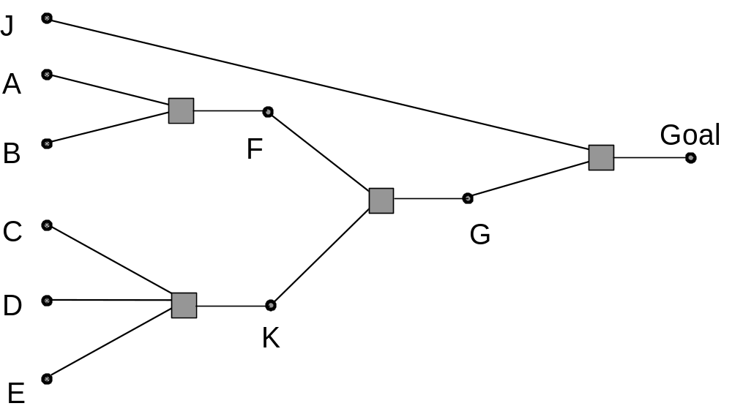
Rule Chaining
If A and B then F
If C and D
and E then K
If F and K then G
If J and G then Goal
• We can Forward Chain from Premises to Goals
• or Backward Chain from Goals and try to prove them.

Slide 14
Forward Chaining
Data-Driven reasoning
  Starts from known data and proceeds forward with that data
Only top-most rule is fired each time
Rule adds new fact to database when fired
Rule can only be executed once
Cycle stops when no further rule can be fired
Notes:
Reasoning in which the focus of attention starts is with known data
In humans e.g. I am indoors and hear rain starting to fall therefore I might think that I need to bring washing in from line
Inference engine works in cycles
In each cycle facts in working memory are updated from information input or deduced in the last cycle
Rules are examined and all rules whose antecedents are satisfied are triggered
The collection of triggered rules is called

Slide 15
Forward Chaining
How does it work ?
  In cycles
  Facts in working memory are updated with information input or inferred from last cycle
  Rules are examined and all rules whose antecedents are satisfied are fired
  Collection of triggered rules is termed the conflict set
  Conflict has to be resolved as only one rule can be fired
Notes:
Our example : we have five rules and four were fired
Rule 4 C -> L was unrelated to goal of determining z

Slide 16
Forward Chaining Example
Rule 1 : IF Y AND D THEN Z
Rule 2 : IF X AND B AND E THEN Y
Rule 3 : IF A THEN X
Rule 4 : IF C THEN L
Rule 5 : IF L AND M THEN N
Database initially includes facts A, B, C, D, E
Notes:
Cycle 1 : Only rules that are triggered are Rule 3 and Rule 4
Rule 1 is fired as topmost rule
So Fact X is added to database
Rule 4 is then fired so fact L is added to the database
Cycle 2 : Rule 2 is triggered
And Y is added to the database
Cycle 3 : Rule 1 is fired
z in the database
The cycle then stops because rule 5 does not match all the facts in the database

Slide 17
Forward Chaining
Gather information and inferring from it
Many rules may be executed that have nothing to do with the goal
May not be efficient
User is never asked to input additional facts
Notes:
Forward chaining is a means of utilizing a set of condition-action rules. In this mode of operation, a rule-based system is data-driven. We use the data to decide which rules can fire, then we fire one of those rules, which may add to the data in working memory and then we repeat this process until we (hopefully) establish a conclusion.

Slide 18
Backward Chaining
Goal-Driven reasoning
System has a goal, inference engine attempts to find evidence to prove it
Search knowledge base for rules that might lead to goal
  Have goal in their action parts
If condition of such rule matches fact in database then rule is fired and goal is proved
Notes:
Rarely have a case where there is a rule that completely satisfies the entire goal so what does the inference engine do
One needs to know which possible conclusions of the system one wishes to test for. Suppose, for example, in a medical diagnosis expert system, that one wished to know if the data on the patient supported the conclusion that the patient had some particular disease, D.

Slide 19
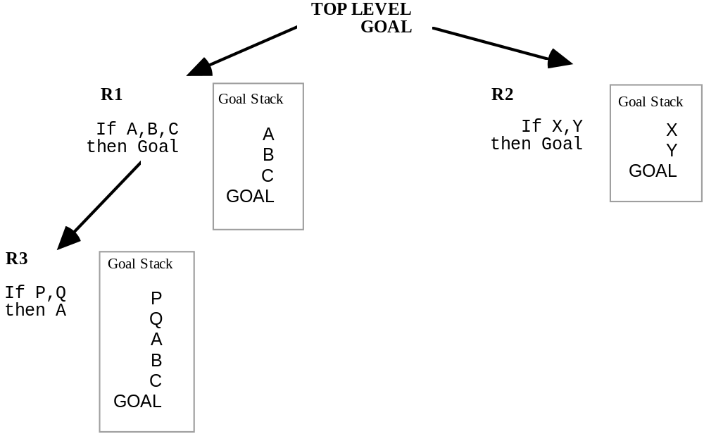
Backward Chaining
Select rules with conclusions matching the goal and create a search tree, each rule selected will become a node in the search tree and will have a goal stack associated with it.
Select one of these nodes as a sub-goal and repeat step 1.
If a goal is proved end by firing the correct string of rules.

Slide 20
Backward Chaining
How does it work ?
  In cycles
  Stack rule
  Set up sub-goal to prove condition
  Search for rules to prove sub-goal
  Continue process of stacking until no rules found that can prove sub-goal
  Most efficient when want to infer one particular fact
  User may be asked to input additional facts
Notes:
Rarely case that a rule will lead to goal totally
Backward chaining is a means of utilizing a set of condition-action rules. In backward chaining, we work back from possible conclusions of the system to the evidence, using the rules backwards. Thus backward chaining behaves in a goal-driven manner.
Suppose, for example, in a medical diagnosis expert system, that one wished to know if the data on the patient supported the conclusion that the patient had some particular disease, D.
In backward-chaining, the goal (initially) is to find evidence for disease D. To achieve this, one would search for all rules whose action-part included a conclusion that the patient had disease D. One would then take each such rule and examine, in turn, the condition part of the rule. To support the disease D hypothesis, one has to show that these conditions are true. Thus these conditions now become the goals of the backward-chaining production system. If the conditions are not supported directly by the contents of working memory, we need to find rules whose action-parts include these conditions as their conclusions. And so on, until either we have established a chain of reasoning demonstrating that the patient has disease D, or until we can find no more rules whose action-parts include conditions that are now among our list of goals.
Our example : initial database A, B, C, D, E
Our goal is to establish Z
Cycle 1: attempt to infer Z. Search for a rule finds Rule 1
So Y and D must be established
Stacks Rule 1
Pass 2: Sets up subgoal Y, checks database its not there so search for rule that has Y as its consequent
Finds and stacks Rule 2: x and b and e -> y
Pass3 : sets up subgoal x, checks db not there so search for rule with x as consequent
Finds and stacks rule 3 a -> X
Pass 4 finds a in database so rule 3 is now fired
Pass 5 returns to subgoal Y and again tries to execute rule 2 x and b and e -> y
Can now be fired
Pass 6 returns to subgoal z and finds can now fire rule 1
Difference doesn’t have to fie rule 4

Slide 21
Forward v’s Backward Chaining
Data-driven reasoning is appropriate when there exist many equally acceptable goal states, a narrow body of facts and rules and a single initial state.
  Required facts are available
  It is difficult to form a goal to verify
Goal directed inference is relevant when:-
  Relevant data must be acquired during the inference process
  Large number of applicable rules exist

Slide 22
Conflict Resolution Strategies
Use first rule whose condition is satisfied
  Ordering is important
Assign priorities to rules & use one with highest priority
  How to decide on priority
Use most specific rule
  Termed Longest Matching Strategy
  One with most detail or constraints
Use rule that matches most recently added piece of knowledge
Chose rule arbitrarily
Construct multiple copies of database and use all rules in parallel
Search for most appropriate rule
Notes:
Can’t really construct rules for every conceivable situation
Very big rule base for start makes for slow programs
Also not going to be very adaptable to new situations
First rule : suppose in our traffic lights rule base we have 3 rules could get wrong conclusion
Establishing priorities : works well if have a small number of rules
Most specific rule : premise that a specific rule contains most detail
e.g. if season is autumn and sky is cloudy etc vs if season is autumn
Most recently added : time tags on data useful for real-time expert systems

Slide 23
Metaknowledge
Knowledge about knowledge
Knowledge about use and control of domain knowledge
Represented by metarules
A metarule determines a strategy for the use of task-specific rules
Knowledge engineer provides it
  E.g.
  Rules supplied by experts have higher priority than those supplied by new users
  Rules that indicate meningitis have higher priority than those indicating influenza

Slide 24
Advantages of Rule-Based Expert Systems
Natural knowledge representation
Uniform structure
Separation of knowledge from processing
Dealing with incomplete or uncertain knowledge
  Certainty factors
  Represent uncertainty by numbers e.g
  {cf 0.1} { cf 0.9}
  Establish level of confidence or belief
Notes:
Representation : expert usually explains problem solving procedure as in this situation I do something so they translate naturally to if then
Uniform : if-then self-documenting
Spearation : makes system smarter
Incomplete and uncertain : use certainty factors

